Slide 1
Crop production analysis
By Unmilan Baruah

Slide 2
Introduction
The Agriculture business domain, as a vital part of the overall supply chain, is expected to highly evolve in the upcoming years via the developments, which are taking place on the side of the Future Internet. This report uses a dataset which provides a huge amount of information on crop production in India ranging from several years. Based on the information the ultimate goal would be to predict crop production and find important insights highlighting key indicators and metrics that influence crop production. The following section makes a brief mention about this report. Finally, observations are recorded and conclusions are made.

Slide 3
Purpose
To analyze crop production based on Indian states.
To study crop production on yearly basis with the help of time series analysis.
To analyze crop production based on seasons.
To understand the distribution of crops across India.
To analyze distribution of crops based on seasons.
To study distribution of crops on yearly basis with the help of time series analysis.

Slide 4
Methodology
ETL (Extract, Transform, and Load): Collecting the data, transforming it into something which can be analyzed with accuracy, and loading the processed data for further analysis.
Data Analysis
Observations
Inference

Slide 5
ETL (Extract, Transform, and Load)
The data source is named as “Crop production data.csv” and this CSV file records related to production of crops.
There are total 246091 entries, and there are missing values in the Production column. Therefore, we have to exclude them while doing production analysis using both Python as well as Tableau.
Moreover, outliers can also be observed in the Area, and Production column. However, for the accuracy of the analysis and to avoid bias, we won’t remove the outliers. Also, we aren’t making any machine learning model for performing predictive analysis. So, removing the outliers is not an appropriate option.

Slide 6
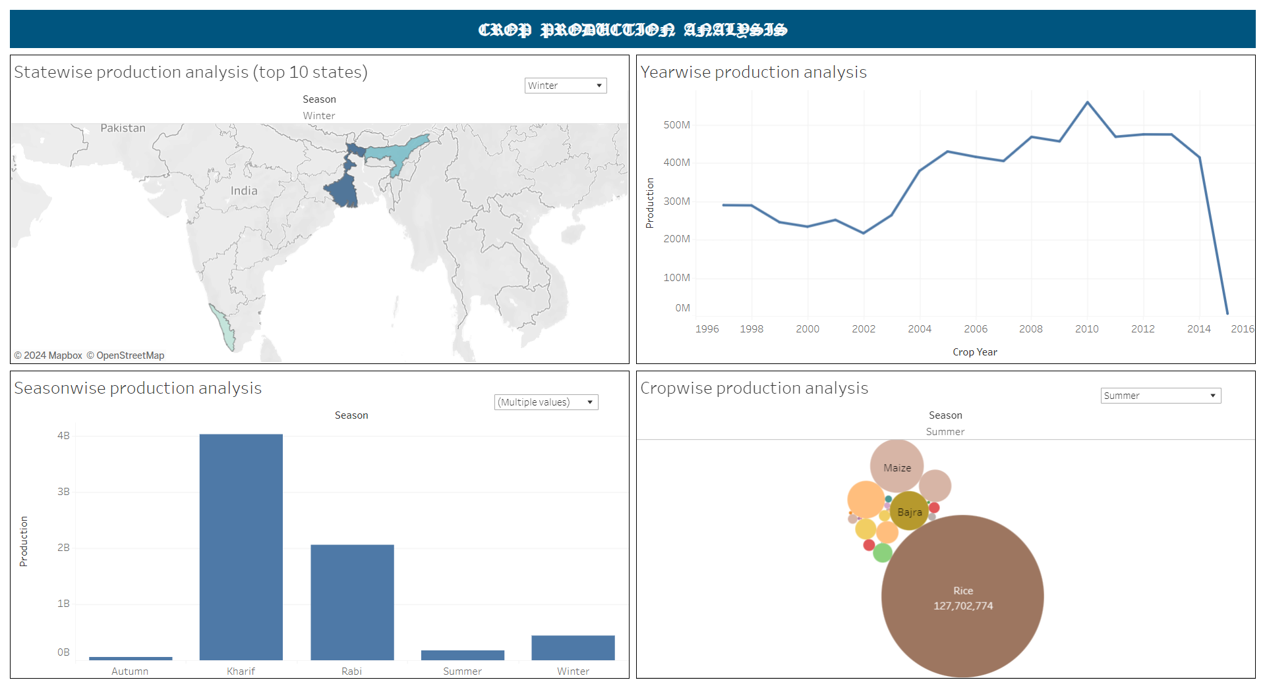
Data Analysis

Slide 7
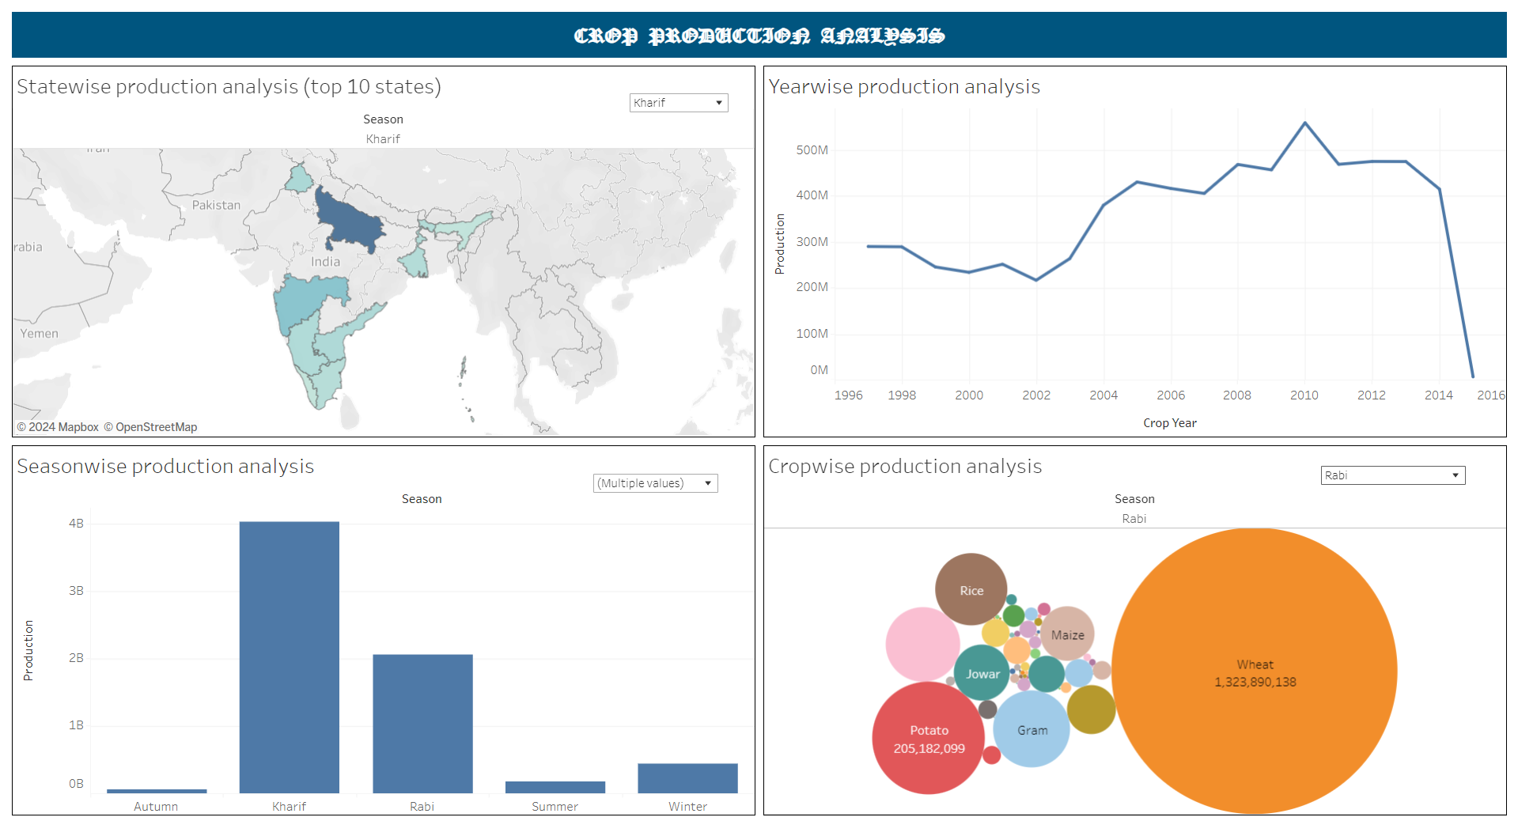
Data Analysis

Slide 8
Observations
Overall production is highest in state of Uttar Pradesh during the Kharif, and Rabi season. While, during the season of Autumn, Summer, and Winter, the production is the highest in West Bengal.
The overall production is highest during the season of Kharif, and Rabi. Moreover, the production is above 2 Billion during both the seasons.
Also, overall production of Wheat, and Sugarcane is the highest during the season of Rabi, and Kharif, respectively. While the production of Rice is the highest during the season of Autumn, Summer, and Winter.
Overall production of crops is the highest during the year 2010. While the lowest production is observed during the year 2015.

Slide 9
Inference
Clearly, the production of crops is the highest in the state of Uttar Pradesh. This is because of the fact that production of crops is significantly higher in Kharif, and Rabi season.
Production of crops is visible, for all the five seasons, in the states of Kolkata, and Assam. This is also evident from the fact that, along with Kerala, production is observed in these two states during the harsh Winter season.
In all the five seasons, production of Sugarcane, Rice, and Wheat is significantly higher than all other crops. Overall production of above 1 Billion is observed for each of these three crops. This implies that, people in India are fond of Sugarcane, Rice, and Wheat.

Slide 10
Thank You

